Slide 1
Big Mountain Ski Resort

Slide 2
Problem Identification
What opportunities exist for Big Mountain Ski Resort to increase revenue by $1.54M over one season in order to offset the increased operational costs of the newly installed chair lift?

Slide 3
Recommendations and Key Findings
Market supports a higher ticket price than currently being charged by Big Mountain Resort.
Current ticket price: $81.00
Modeled price supported by market: $95.87 (with mean absolute error of $ 10.39)
Recommended operational changes for further consideration:
Increase vertical drop by 150 feet by adding a run to a lower point, requiring the installation of an additional chair lift, without additional snow making coverage.
Permanently close the least-used run immediately.
Consider permanently closing a total of 2 or 5 of the least-used runs. *
Vertical drop improvement can increase daily adult ticket price by $1.99 and revenue by $3,474,638 over the season (assuming ticket sales for 350,000 guests averaging five days per guest).
Notes:
*Closures of additional runs would decrease ticket prices (about $0.40 for 2 total or $0.60 for 3-5 total runs) and would need to be evaluated against the savings in operational costs. As the operational costs per run are unknown, it is not clear whether this would be advantageous, but is worth noting as a possible cost-savings.

Slide 4
Modeling Results and Analysis
Used a random forest regressor model to gain insight into what Big Mountain's ideal ticket price could/should be, and how that might change under various scenarios.*
Features identified as important related to ticket pricing: vertical_drop, Snow Making_ac, total_chairs, fastQuads, Runs, LongestRun_mi, trams, and SkiableTerrain_ac.
Modeled adult weekend price for Big Mountain Resort supported by market: $95.87 (with mean absolute error of $ 10.39)
Current ticket price: $81.00
Evaluated each of 4 possible scenarios for operational changes proposed by management.
Notes:
*Note: decided to use the random forest regressor model to guide business decisions regarding ticket prices because (A) it has a lower cross-validation mean absolute error by almost $1 as compared to the linear model; (B) performance on the test set produces performance consistent with the cross-validation results; and (C) it exhibits less variability. [This information may be too technical for the business leadership audience.]

Slide 5
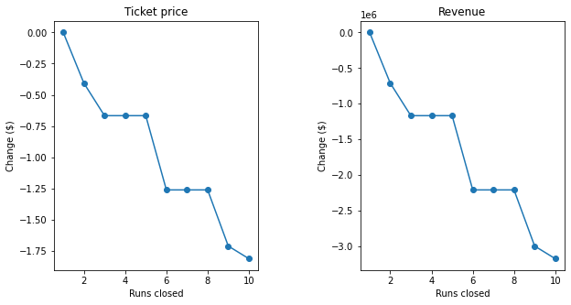
Modeling Results and Analysis
Scenario 1: closing up to 10 of least-used runs to save on operational costs.
Results: closing 1 run has no impact on ticket price; closing 2 or more impacts ticket price.
Recommendations:
Close least-used run.
Consider closing a total of 2 or 5 least-used runs.*
Do not recommend closing 6 or more runs.
Notes:
* If the cost savings outweigh the loss in revenue, I would recommend that Big Mountain considering closing 2 or 5 of the least-used runs. As the impact on ticket price between closing 3, 4, or 5 runs is the same, if Big Mountain were to pursue this route, closing 5 would maximize savings on operational costs.

Slide 6
Modeling Results and Analysis
Scenario 2: increasing vertical drop by 150 feet by adding a run to a lower point, requiring the installation of an additional chair lift, without additional snow making coverage.
Results: $1.99 increase in ticket price/ $3,474,638 revenue increase over the season.
Recommendation: recommend this improvement (assuming that the total cost of both new chairlifts is less than the approximately $3.47M in increased revenue).
Scenario 3: the previous scenario with the addition of 2 acres of snow making coverage.
Results: $1.99 increase in ticket price/ $3,474,638 revenue increase over the season.
Recommendation: do not recommend as there is no additional change in ticket price from Scenario 2.
Scenario 4: increasing the longest run by 0.2 miles to boast a 3.5 mile run, requiring additional snow making coverage of 4 acres.
Results: no impact of ticket prices.
Recommendation: do not recommend.

Slide 7
Summary and Conclusion
Market supports a higher ticket price than currently being charged by Big Mountain Resort.
Big Mountain Resort can increase ticket prices with its facilities as-is.
Operational changes and improvements can impact revenue: closing 1+ runs to save costs and increasing vertical drop to justify higher ticket prices.
Big Mountain can increase revenue by more than the $1.54M over one season in order to offset the increased operational costs of the newly installed chair lift.

